Slide 1

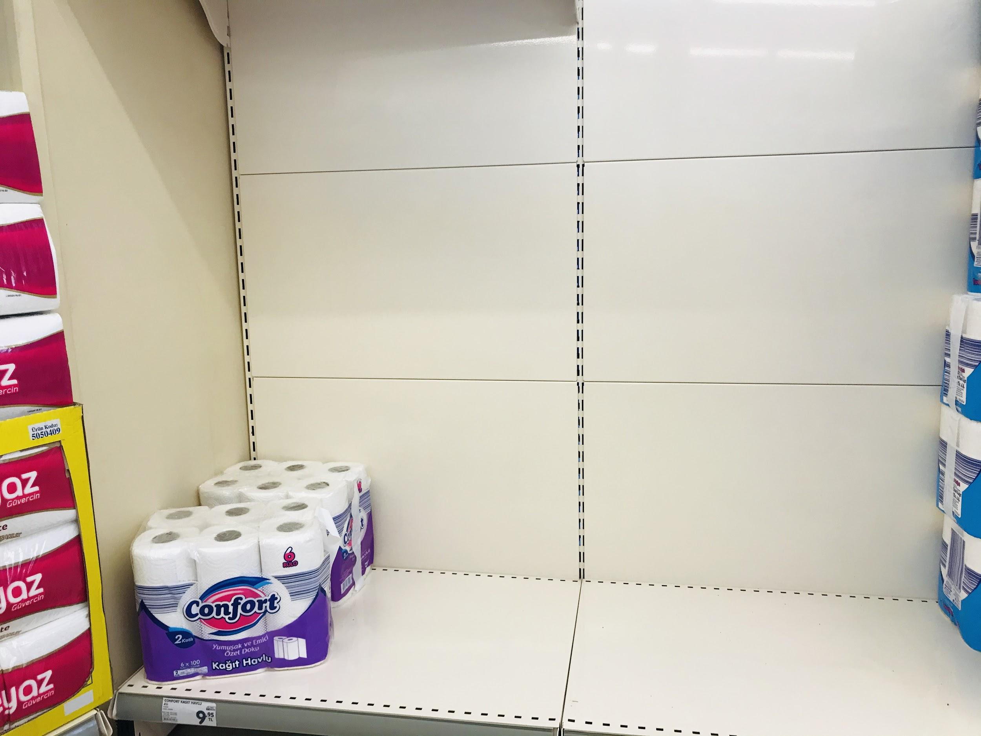
Commodities:
The ETL project
By Dominica Corless, Kelsey Cox,
Jeremy Jang, Jeremy Steele, Stanley Tan

Slide 2



Space? Chess? Baseball? No…
The Choice
Commodity
noun
a raw material or primary agricultural product that can be bought and sold, such as copper or coffee.

Slide 3
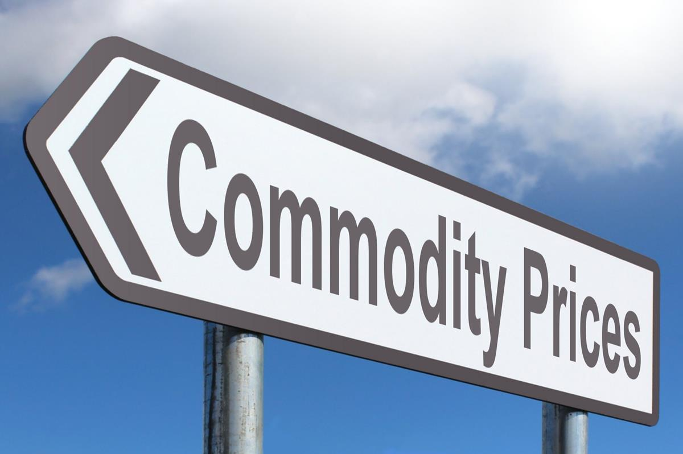
The Commodities
Energy: Natural Gas, Crude Oil
Metals: Gold, Silver, Platinum, Palladium
Agriculture:
Coffee, Sugar, Cocoa, Corn, Cotton
Palm Oil, Rubber
Live Cattle, Live Hogs, Feeder Cattle

Slide 4
The ETL Process
Search for data sources, selecting commodities
Paring down data, converting units
Plotting with Matplotlib
Brainstorm
Extract
Transform
Load
Visualize
APIs and downloading CSVs
Database Design and Loading into PostgreSQL

Slide 5

Extraction
Websites:
Macrotrends.net
Tradingeconomics.com
Worldbank.org
investing.com
Downloaded Data:
Palm Oil and Rubber: International Monetary Fund, retrieved from FRED, Federal Reserve Bank of St. Louis

Slide 6

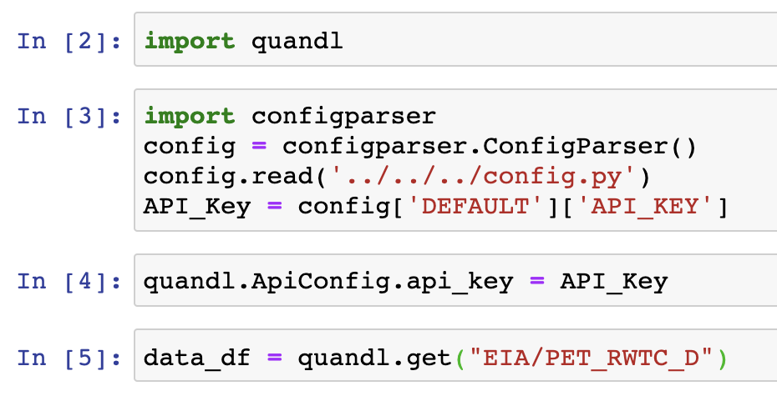
API CALL
Obtaining Data from Quandl
Make a Time Series Call
Use their code for corresponding data set
eg, for WTI Crude Oil Price use "EIA/PET_RWTC_D"
Save as a CSV with Pandas

Slide 7



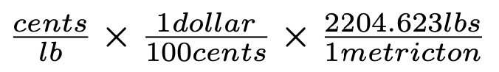
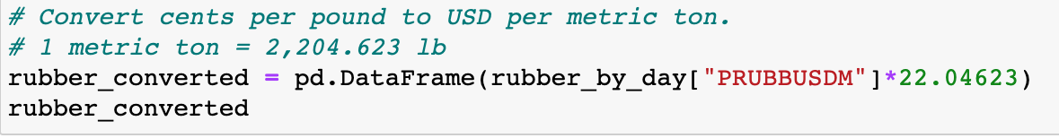
Transformation
Read into pandas as .csv
Rename columns to match the SQL Database
Delete data besides “Date” and “Price per unit”
Convert units as necessary

Slide 8
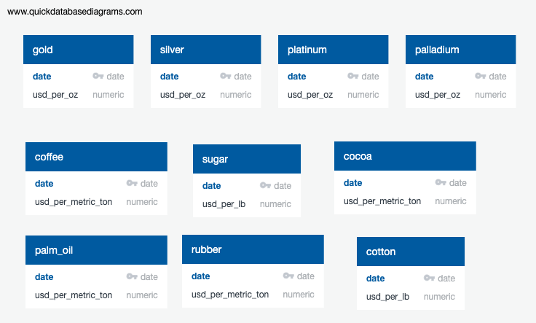
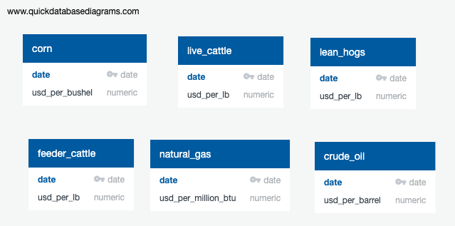
Database Design
PostgreSQL
One table for each commodity
Two columns for each table:
Date (Primary Key)
Currency per unit
Tables can join on date

Slide 9


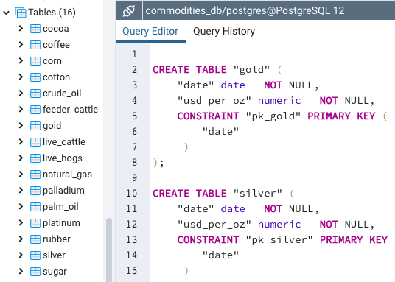
Loading
Table Creation
Quick Database Diagrams Export SQL.
Run CREATE TABLE code in PGAdmin Query Editor

Slide 10
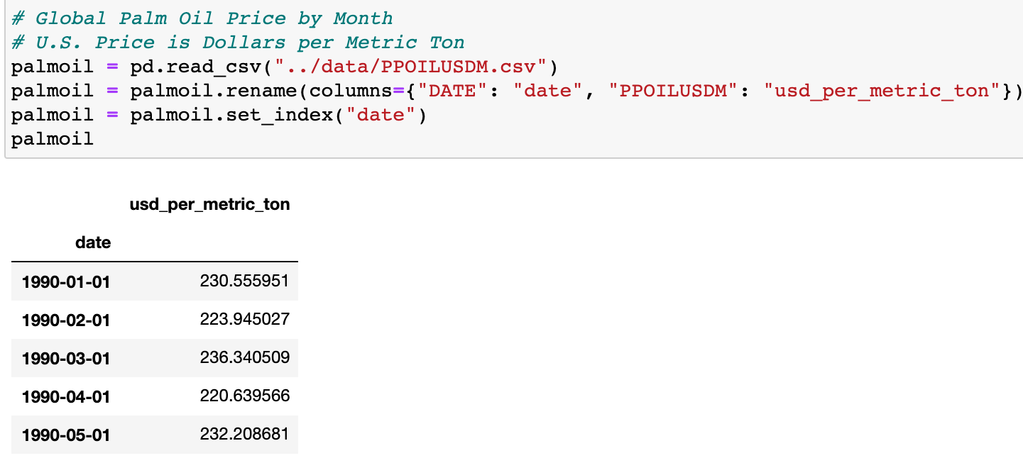
Inserting to PostgreSQL Database
Pandas Insertion
Connect to Postgres
Make sure data frame column headings match SQL table

Slide 11

Overview

Slide 12
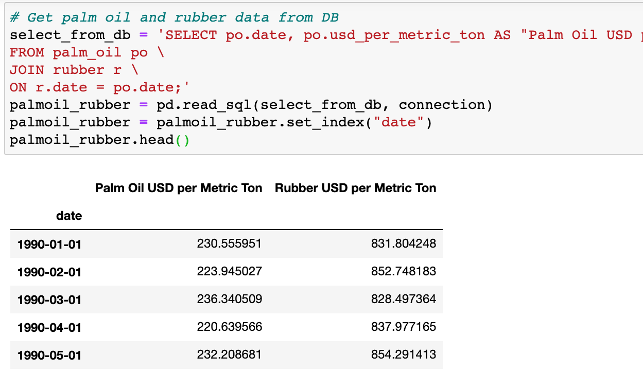
Using the Data from PostgreSQL Database
Joining the Data for Analysis
Pandas is used to read data using SQL statement with JOIN on date.
Rename columns in SQL for Data Frame readability.

Slide 13

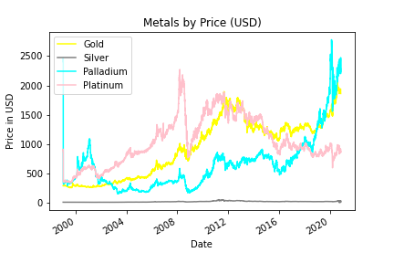
Metals
(Gold, Silver, Palladium & Platinum)

Slide 14
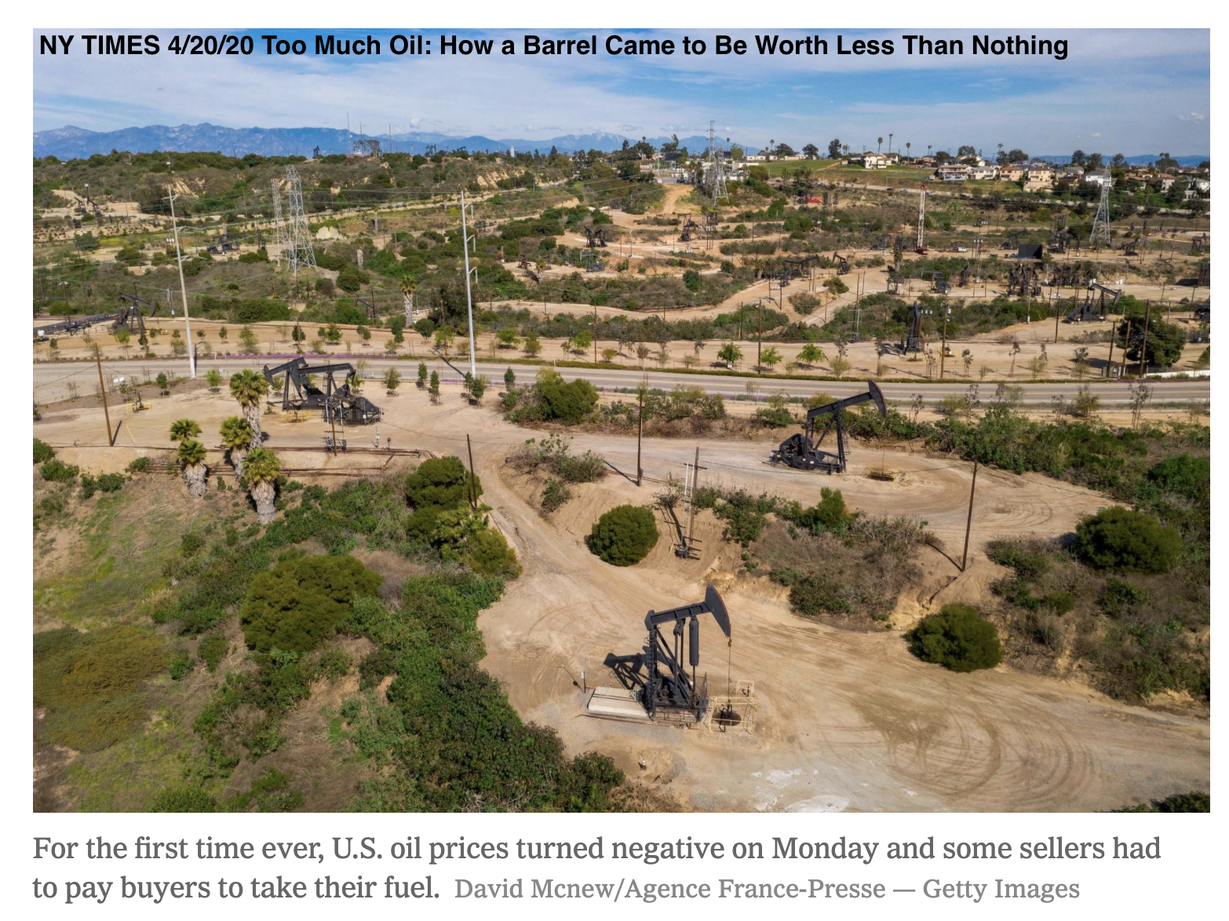
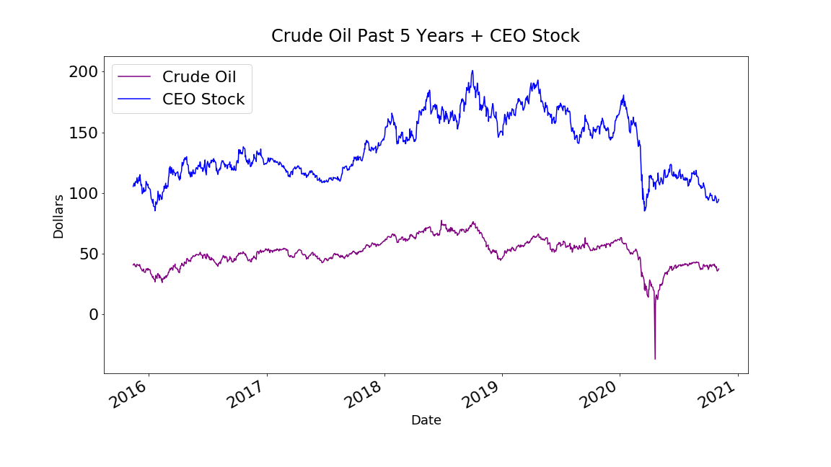
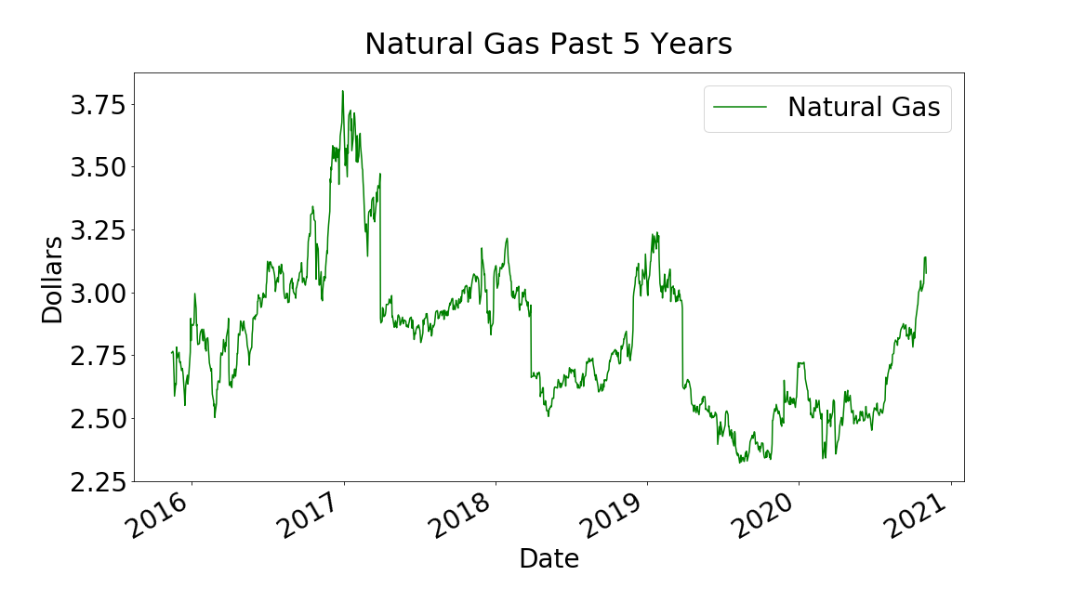
Energy
(Crude Oil, Natural Gas)
Source: Quandl (WTI Crude Oil, Natural Gas Futures), RAPIDAPI (Yahoo Finance)

Slide 15
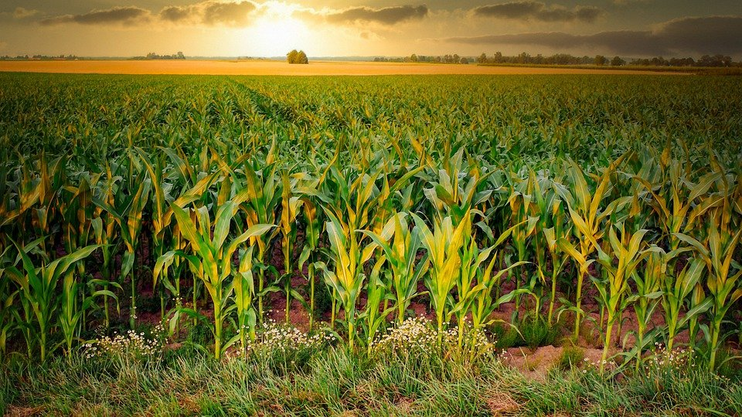
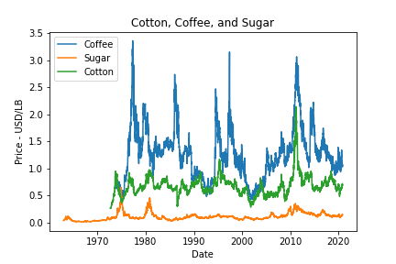
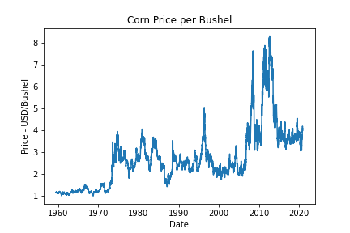
Agricultural Crops
(Cotton, Sugar, Coffee, Cocoa, and Corn)

Slide 16
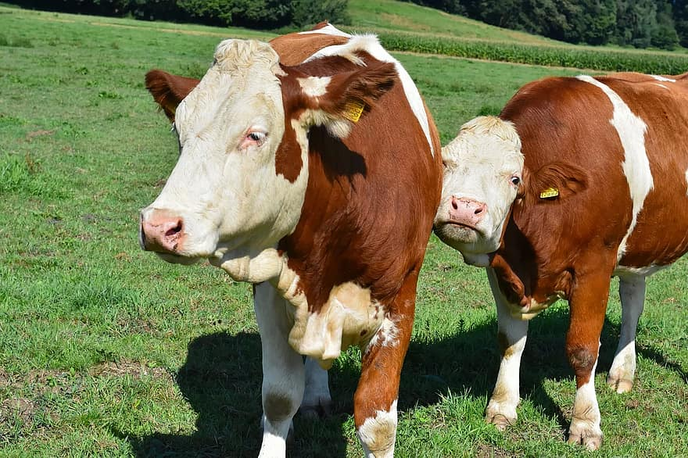
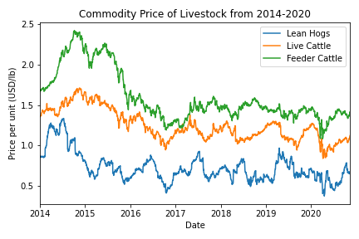
Agriculture Livestock
(Cattle & Hogs)

Slide 17
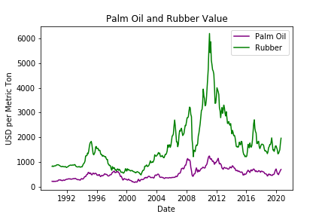
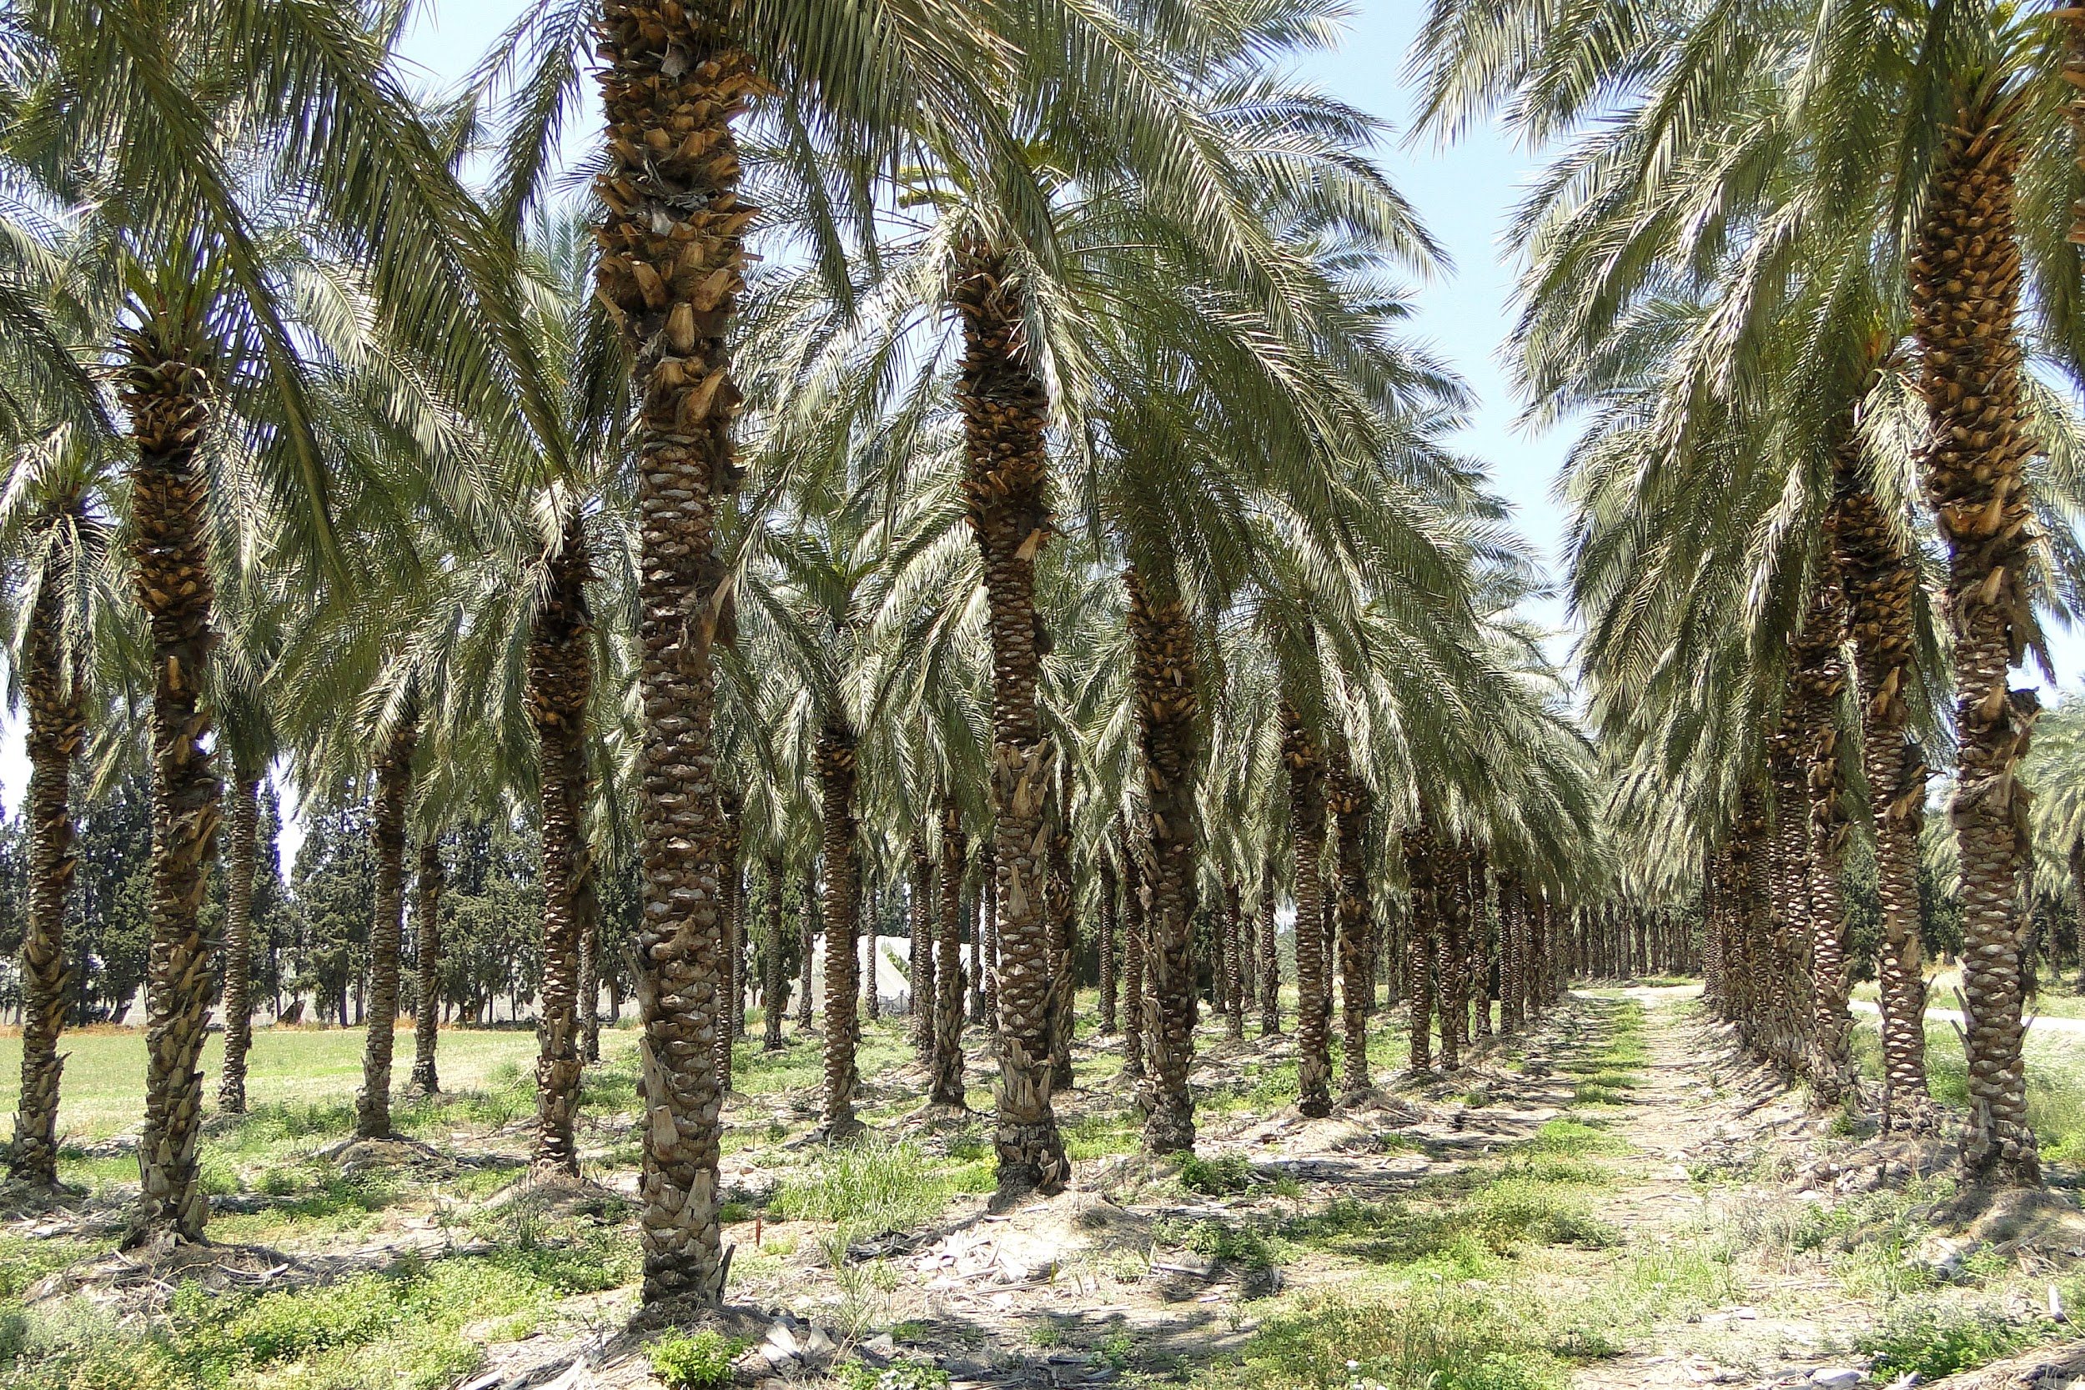
Agriculture Controversial
(Palm Oil & Rubber)
ANALYSIS

Slide 18

Conclusion
Further researching the data relationships
Finding economic, political events to explain price changes
The ETL process went well.
We found good sources, though a wider scope of date would be great
Now, to use this data to make money!!

